Slide 1

Smoothed Complexity of Local Max-Cut
Hofer Nataniel
Master semester project
Supervisor : Dr Ola Svensson

Slide 2
Table of contents
1. Introduction
2. Proof of complexity ffs
3. Results
4. Conclusion

Slide 3
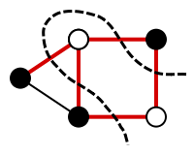
1. Introduction
Given a graph
G = (V,E) :
The Max-cut problem consists
in finding a partition of vertices with a maximum of edges in between

Slide 4
NP-hard problem
Approximation algorithms :
Alpha = 0.5 is trivial
Alpha ≈ 0.878 is the best known
Relax problem ?
Search for a local maximum

Slide 5
FLIP Algorithm
FLIP is a family of algorithm
  Basic concept : Choose a vertex to flip to improve the cut
  Repeat until there is no such vertices : local maximum reached
  Different FLIP algorithms for different policies of choosing the vertex to flip
Issue : Can take exponential number of steps

Slide 6
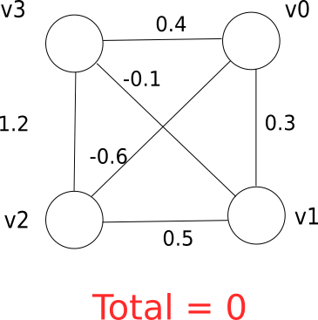
Why running time can be long ?

Slide 7
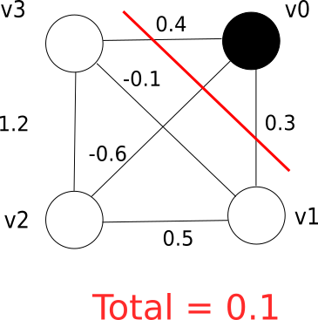
Why running time can be long ?

Slide 8
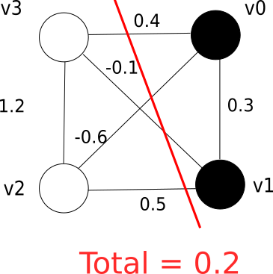
Why running time can be long ?

Slide 9
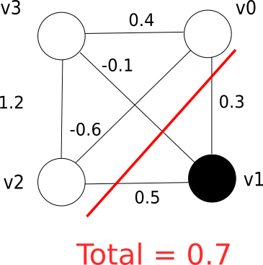
Why running time can be long ?

Slide 10
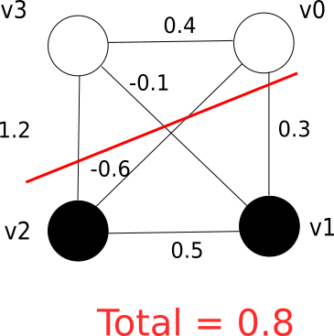
Why running time can be long ?

Slide 11
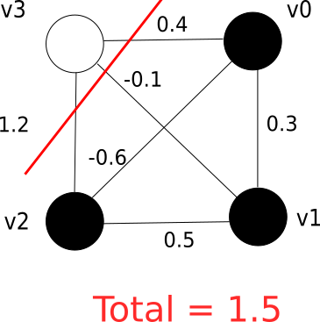
Why running time can be long ?

Slide 12
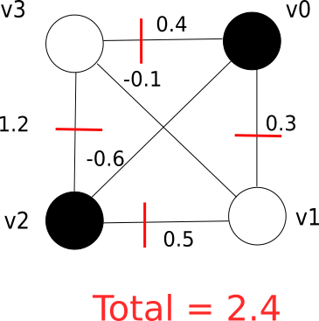
Why running time can be long ?

Slide 13
Study of the smoothed complexity
Worst case instance are fragile, adding noise disrupts them
Study of smoothed complexity
  weights in [-1, 1]
  Density is at most Φ

Slide 14
State of the art
For arbitrary graph FLIP is quasi-polynomial in n (number of vertices)
  Etscheid and Röglin (2014)
For complete graph FLIP is polynomial in n
  Peres et al. (2016)
Polynomial too for graph with low-degrees vertices

Slide 15
Some definitions
A sequence is a word of vectors to flip
  (v0, v1, v0, v2, v0, v1) in the previous example
Flipping a vector is called a move
A move vector is a vector indexed by the edge:
  -1 if the edge leaves the cut
  1 if the edge enters the cut
  0 if the edge is not concerned by the move

Slide 16
Principal Lemma
Let L be a sequence:
  M is the matrix of move vectors of L
  h(L) is the total amelioration brought by L
P{h(L) ∊ [0, ε]} < (φε)^{rank(M)}
The goal is to find subsequence of high rank

Slide 17
Proof for low degrees
Given a graph (V, E) where all v in V have degree at most log(n):
Use principal lemma with union bound
  N vertices
  2^{log(n)} configuration for each vertex
P(h(v) < ε) < n²φε
  here it is for any vertex v from any configuration

Slide 18
Proof for low degres (continued)
P(h(v) < ε) < n²φε
  With high probability, each move leads to an improvement of at least ε
  Maximum improvement = 2n² (max #edges = n², weight(edge) ∊ [-1,1]
  Maximum steps required : 2n²/ε
Taking ε = n⁻³ , with high probability the complexity is polynomial in n

Slide 19
Other graphs
Naïve union-bound leads to a unsatisfying bound
Solution : Use union-bound on specific subsequences with good rank
Problem : find specific subsequences with good rank

Slide 20
Complete graphs (Peres et al. 2016)
Notion of critical blocks
  Substrings of sequence defined by ratio :
  length(Block) / different vertices(Block)
They are of high rank because :
  Graph is complete
  vertices that appear only once act as pivot

Slide 21
Complete graphs (continued)
High rank is important to counter the effect of unmoving vertices
The effect of unmoving vertices is discretized : union-bound is cheaper

Slide 22
Graphs we studied

